Slide 1
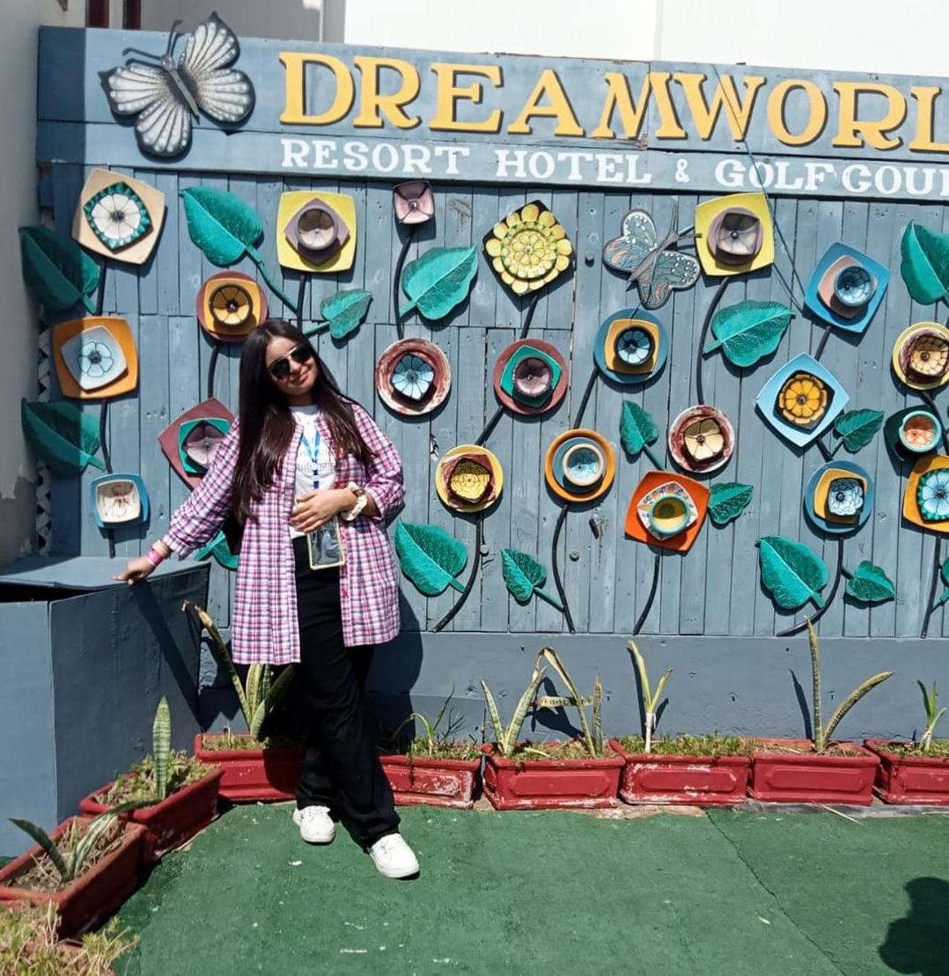
Zarnish Tirmizi
UNVEILING THE JOURNEY THAT SHAPED HER:
A life in moments, memories, and milestones.

Slide 2
Intro:
Zarnish Tirmizi, a visionary teacher with enthusiasm and ready to start her Charted Accountant journey and thrilled to begin her passion with profession with a positive attitude, recently completed her intermediate in Commerce and continuing studies ...

Slide 3
Personality Traits:
Imagination, curiosity, the enjoyment of abstract thinking and ideas.
1
Having a strong character means making decisions based on a set of core values. Here are my several personality traits ...
Consistency following through on commitments.
2
Perseverance and passion for long – term goals.
3

Slide 4
Strengths & weakness:
Everyone has some strengths and weakness and their lives and same as, mine are the following...
Fear of failure
Self – criticism
Impatient
STRENGTHS &
WEAKNESS
Dedicated
Ability to work under pressure
Creative thinker
Collaboration and communication
Self – Awareness
About me.

Slide 5






ACADEMIC ACHIEVEMENTS:
I have been a topper since childhood, and because of this, I have also received awards and proud of my abilities and skills. My institutions had awarded me by various awards and honors.
2nd Position
In Suparco
Poster competition
SILVER MEDAL
IN HRCA QUIZ
COMPITITION
Top 20th Position in intermediate 2024
2nd position in comic book making competition
IMPACTFUL CHART
Maker
Highest percentage In School

Slide 6
Interests:
FAVOURITE TOPIC:
FUTURE GOALS:
ROLE MODEL:
Love to wander new places.
Art and crafts.
Explore more about World.
Solving Mathematical problems, as is it my favourite subject.
I want to become a Charted Accountant (CA)
And also want to learn graphic designing and advance Information Technology.
I like to talk more about cricket matches and also favourite topic of discussion is to get more information about Charted Accounting (CA).
My ‘GRANDMOTHER ‘ is my role model because she was very hardworking woman and also Principal of school.

Slide 7
Skilled learned in this course:
I have learned about IT, Input and output devices, software and hardware and operating system.
Learned how to create GitHub, Linked in and Slack accounts.
Learned about Microsoft Office including how to install MS OFFICE in PC.
Learned MS WORD, MS EXCEL, MS POWERPONT, also related information about these.
Learned different shortcuts keys which make it easy to use PC.
Learned Python Programming, Networking etc.
Learned how to make CV on different platforms, Expense tracker, Certificates, Presentations etc.

Slide 8
Fun fact about me:
If I were a genius inventor, I would most likely to invent a “Mind Reading Device” through which, I can read people’s mind.
. Thank-you .

